Slide 1
Linear regression: log transformation

Slide 2
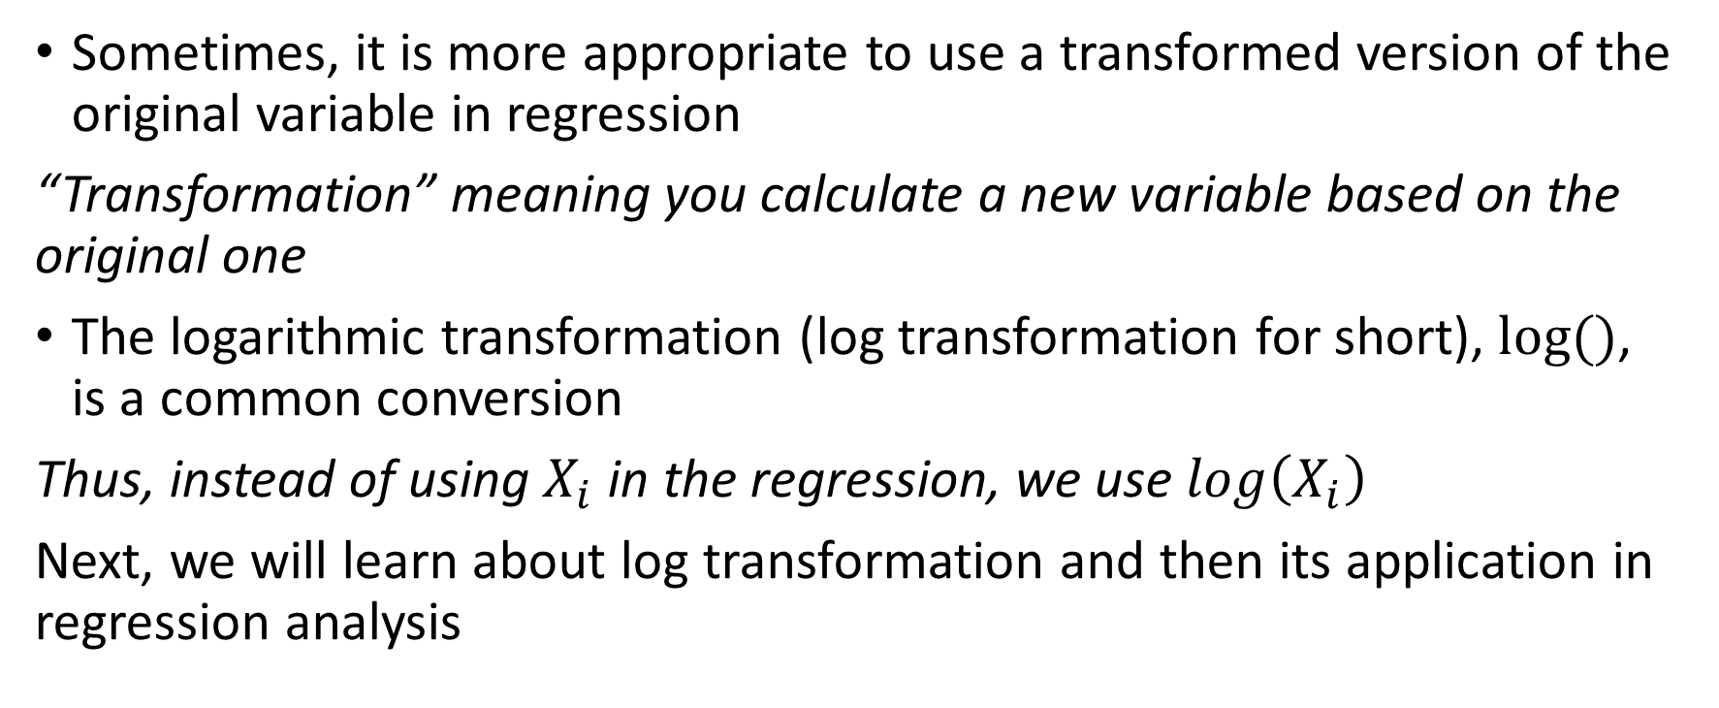
Variable transformation
Sometimes, it is more appropriate to use a transformed version of the original variable in regression
“Transformation” meaning you calculate a new variable based on the original one
The logarithmic transformation (log transformation for short), $log⁡()$, is a common conversion
Thus, instead of using $X_{i}$ in the regression, we use $\log\left(X_{i}\right)$
Next, we will learn about log transformation and then its application in regression analysis

Slide 3
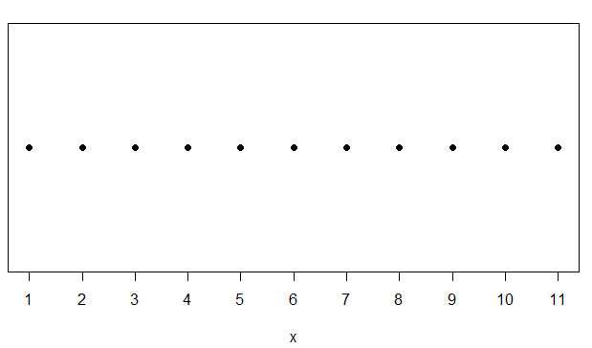
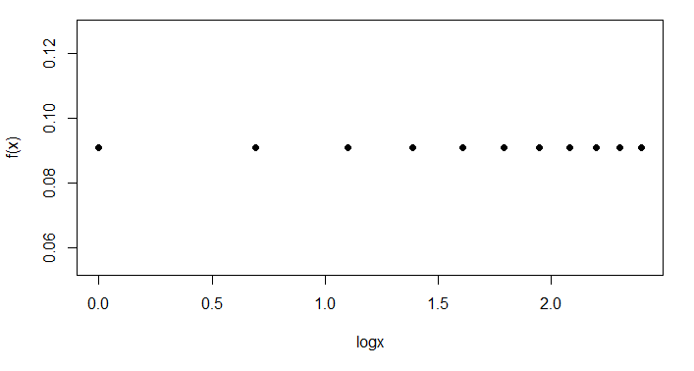
Log transformations
Intuitively, you can think of log transformation as a way to scale the variable around its median in a peculiar way
For ease of understanding, consider
a variable X {1,2,3,4,5,6,7,8,9,10,11}.
Its median is 6 (median(X) in R)
log(X)={0.0000,0.3010,…,1.0414}; its
median is 1.7918 (still the 6-th observation, log(6))
Median
Log(6)=1.79
median
1 2 3 4 5 6 7 8 9 10 11
6th
Stretched
Squeezed
Observe the change in relative distance to the median

Slide 4
Log transformations
Intuitively, you can think of log transformation as a way to scale the variable around its median in a peculiar way
For ease of understanding, consider
a variable X {1,2,3,4,5,6,7,8,9,10,11}.
Its median is 6 (median(X) in R)
log(X)={0.0000,0.3010,…,1.0414}; its
median is 1.7918 (still the 6-th observation, log(6))
Median
Log(6)=1.79
median
1 2 3 4 5 6 7 8 9 10 11
6th
Stretched
Squeezed
Observe the change in relative distance to the median

Slide 5
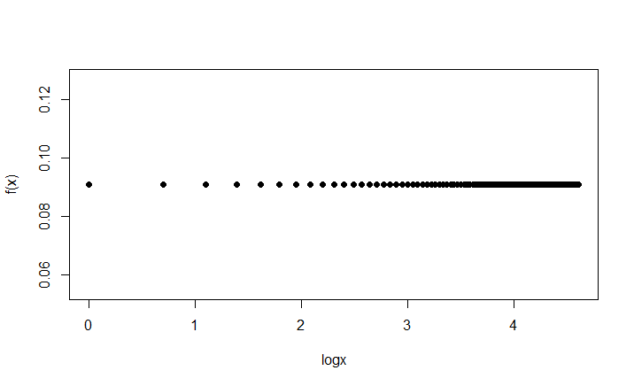
X=c(1:100) and its log transformation
>x <- c(1:100)
>logx <- log(x)
Median around here
Stretch
Squeeze

Slide 6
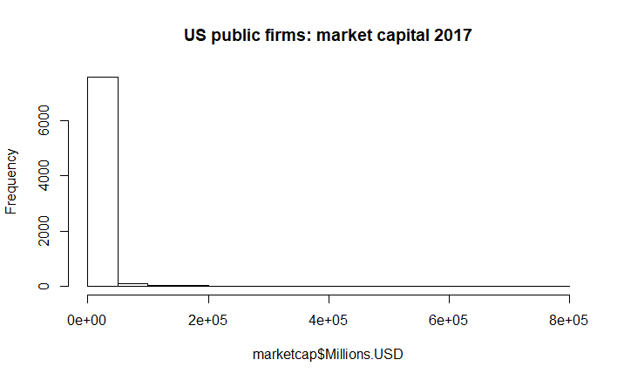
Many empirical distributions right-skewed
A right-skewed distribution has a long right tail relative to its “peak” (i.e., the distribution has a few very large values)
For a right-skewed DV, log-transformation can make the distribution more “normal,” which improve the inference in regression
marketcap US public firms 2017.csv

Slide 7
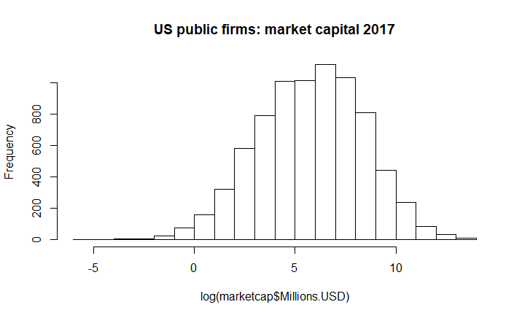
Distribution of the log-transformed variable

Slide 8
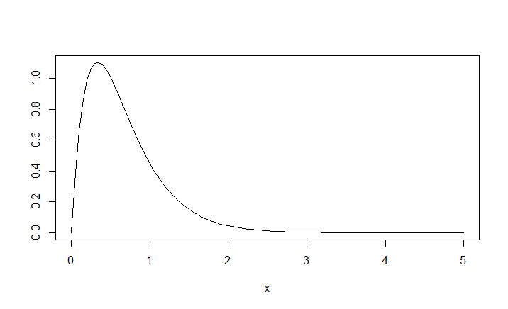
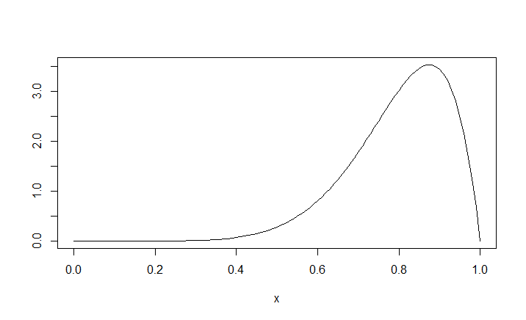
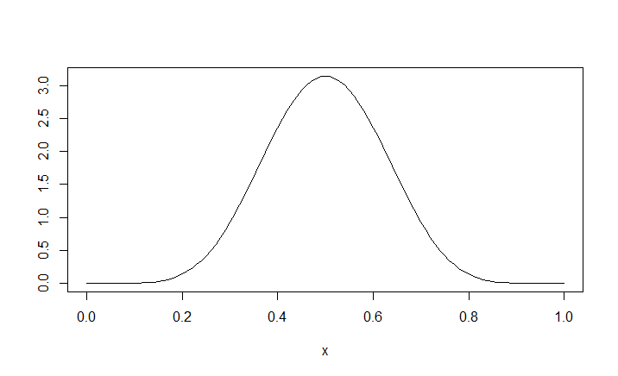
Skewness of a distribution
In R, you can evaluate the sample skewness (a statistic) of a variable by the “skewness()” in the “moments” package (first-time user, use install.packages(“moments”) to install the package, followed by library(moments) )
Negative skewness (left-skewed)
Skewness is about zero
(~normal distribution)
Positive skewness (right-skewed)
We use >+1, <-1 as the rule of thumb. Skewness >+1 or <-1 is considered highly skewed. Thus when skewness > +1, you can consider applying the log-transformation to your DV

Slide 9
Changes in coefficient interpretations
While log transformation can restore normality of distributions, the problem of normality would be immaterial in the presence of large samples (say, from a few dozens and few hundreds; thanks to CLT)
The “log-or-not” decision is more often based on purpose of your study
Log transformed variables give a “% change” interpretation for the DV and IV’s
“…1% increase in blood pressure is associated with ?% decrease in work productivity”
That is, if you believe (based on theory, your knowledge, etc) that the IV affects the DV by “%” rather than on a “per unit” basis, then you should adopt the log transformation (for IV or DV)
Of course, when you don’t have such prior information, you can refer to skewness to make the call

Slide 10
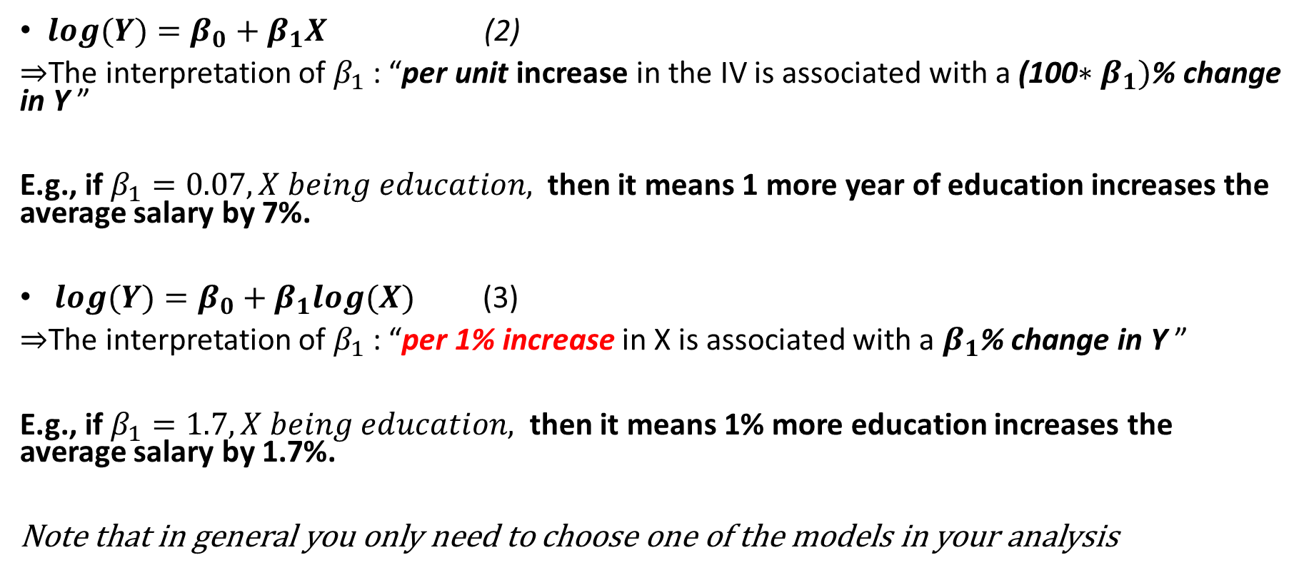
Changes in coefficient interpretations
$log(Y)=β_{0}+β_{1}X$ (2)
$⇒$The interpretation of $β_{1}$: “per unit increase in the IV is associated with a (100$∗β_{1})$% change in Y ”
E.g., if $β_{1}=0.07, X being education,$ then it means 1 more year of education increases the average salary by 7%.
$log(Y)=β_{0}+β_{1}log(X)$ (3)
$⇒$The interpretation of $β_{1}$: “per 1% increase in X is associated with a $β_{1}$% change in Y ”
E.g., if $β_{1}=1.7, X being education,$ then it means 1% more education increases the average salary by 1.7%.
Note that in general you only need to choose one of the models in your analysis

Slide 11
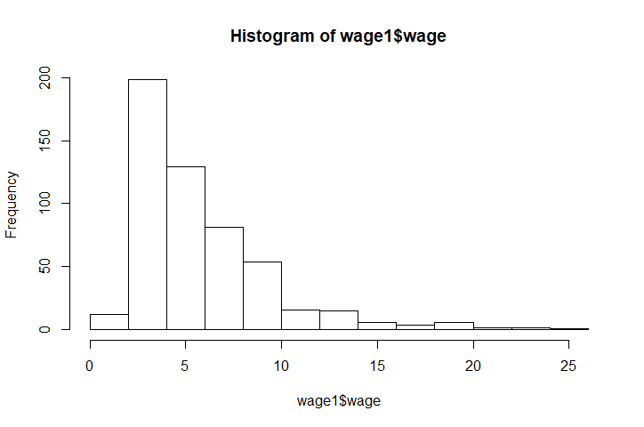
Applications-the monthly earning study
# Check the skewness of the DV
>library(e1071)
>skewness(wage1$wage)
2.001603
# >+1, so log transformation is advisable
>reg.results.wage1log <-lm(log(wage) ~ educ + exper + tenure + female, data= wage1)
>summary(reg.results.wage1log )

Slide 12
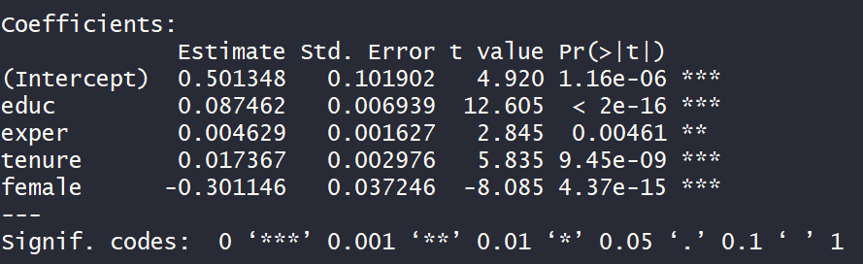
log(wage) ~ educ + exper + tenure + female
“the regression results show that one-year increase in education experiences is associated with a 8.7% increase in average hourly earning (statistically significant at the 0.1% level)”
“…females’ hourly earning are 30% lower than males’ (statistically significant at the 0.1% level)”

Slide 13
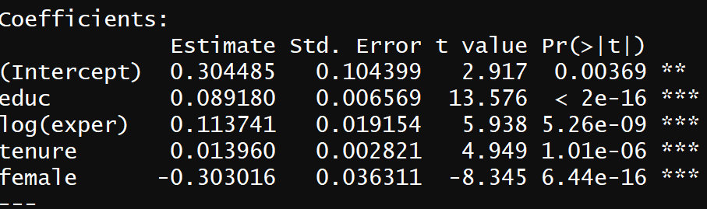
log(wage) ~ educ + log(exper)+ tenure + female
“the regression results show that 1% increase in work experiences is associated with a 0.11% increase in average hourly earning (statistically significant at the 0.1% level)”

